Slide 1
User Interfaces for
Embedded Systems
Presentation 7:
Usability Testing

Slide 2
The problem with predictive methods & heuristics / guidelines
Makes overall assumptions
  May often be right (that’s why we use them)
  May sometimes be inadequate
Makes assumptions on behalf of the users
  Do we really know if these holds to be true?
Are we
  building the right product – or are we “only”
  building the product right
The solution: consulting the users

Slide 3
The Users
Four important guidelines apply (Nielsen):
  Remember that you are NOT your typical user
    “The designer” is not a good user
  Know your users
    “Everyone” is not a user
    “The Vice President” is rarely the user
    “Marketing” is rarely the user
    If you can’t find a user – then you’re in big trouble!
  Users aren’t designers
    It is your job to generate visions (prototypes, future workshops) and to collect their feedback
  Users aren’t all-knowing
    Beware of users giving you wrong information – use & study several

Slide 4
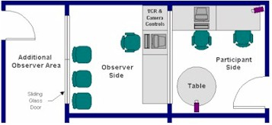
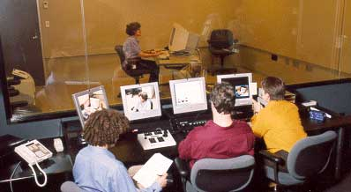
Non-invasive Usability Labs
User observable in an isolated setting
Data collection of user performance
Based on Cognitive HCI
Isolates specific task from others
Expensive! Microsoft, Sun, IBM, Nokia
Impractical?

Slide 5
The Context
Original Cognitive HCI is not concerned with the context where the work is situated
Focus is on the mapping between the user & the computer in an isolated setting
This approach has various flaws

Slide 6
The “new wave” of HCI psychology
Social Computing (born in the late 80’s)
  Users are not isolated beings
  They are part of a context – social & cultural
  Not possible to isolate the work context completely in a lab
Solution
  Study the users at the work setting (field studies & interviews)
  Integrate users in the development team

Slide 7
Social Computing Concepts
Distributed Cognition
Situated Action Theory
Activity Theory
Participatory Design (field studies & interviews)
Prototyping
XP: eXtreme Programming (and other Agile Methods)

Slide 8
Techniques for Observing and Listening to Users
Field studies / Contextual Inquiry / Shadowing
Lab observations
Diary
Think Aloud: talk while doing the job
Talk Right After : debriefing after the job
Role Playing
Cueing recall with videotape (Focus Shift Analysis)
Focus groups & interviews
Mailed surveys
Others: Retrospective Testing, Coaching Method, Constructive Interaction
Notes:
These are all covered, with at least one slide each.

Slide 9

Think Aloud
Psychological Test Method
Both lab & in situ
(Tognazzini, 1992): might be big controlled lab experiments with video cameras – or cheap no nonsense studies
“May be the single most valuable … method” (Nielsen, 1993)
Makes the users mental model of the system clear to us – to close the gap to the system model

Slide 10
Think Aloud
Samples of facilitating remarks:
  “Could you tell me what options you are considering?”
  “Is anything in particular puzzling you?”
  “What might you do next?”
No feedback, positive or negative
No answers or hints
If users get stuck, have them go on
Neutral demeanor at all times
”I’m not the designer”

Slide 11
Think Aloud Exercise (10 min.)
Divide into groups of two’s
Turn off Bluetooth on both off your phones
Switch mobile phones
Task:
  Start with first participant:
  Attempt to discover and pair with a phone
  Second participant simply observeres – no interaction
  But do take notes !
  Now switch – second participant perform task – but now using Think Aloud
  First participant is facilitator – only facilitating remarks
Discuss with neighbour – which method works best?
Plenum: we will discuss the experiences

Slide 12
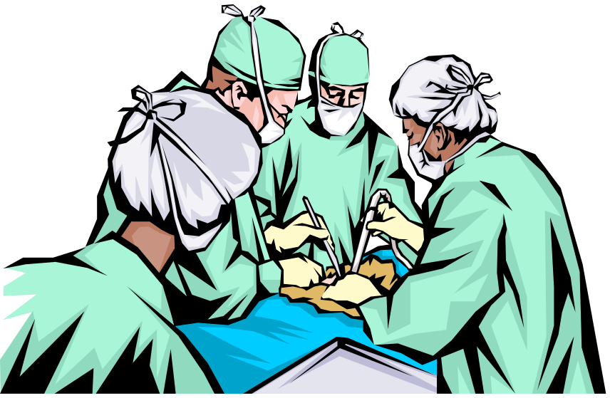
Talk Right After
Sometimes talking while doing
the work is not feasible or unsafe
Notes:
Be careful in using this kind of illustration on a quiz or exam. Some students may know that surgeons doing a familiar procedure talk all through an operation—about baseball. Be sure to add “Explain you answer.” If the explanation shows they know what they are talking about, take it.
Similarly for the air traffic control review question. Most people think of the controllers in the tower at an airport—but those people control only planes on the ground. The arrival/departure controllers are in a darkened room somewhere, and the 12 enroute sector controllers for the United States are yet someplace else. At 8am at O’Hare, nobody is going to talk with an observer. But at 2am there isn’t much going on and they may be able to talk freely. (My first consulting was with the FAA, and I’ve spent some dozens of hours watching and talking with enroute controllers.)

Slide 13

Talk Right After
Talking right after may be best alternative to thinking aloud

Slide 14
Recruiting Users
If product is in use, test with real current users:
  Employees
  Customers
If it is a new product, test with potential users
Provide incentives:
  Coffee mugs, T-shirts, wine
Not family or friends:
  they won’t be critical enough
Ethical aspects
  Conduct all test with the deepest respect for their well-being
Users are only “novice” users the first time!
  Do not waste your usability testing resources on basic problems – make sure your product is ready for testing
Notes:
Having the second-level entries appear with their first-level headings is deliberate: there isn’t much need for detailed discussion of “Employees” and “Customers.”

Slide 15
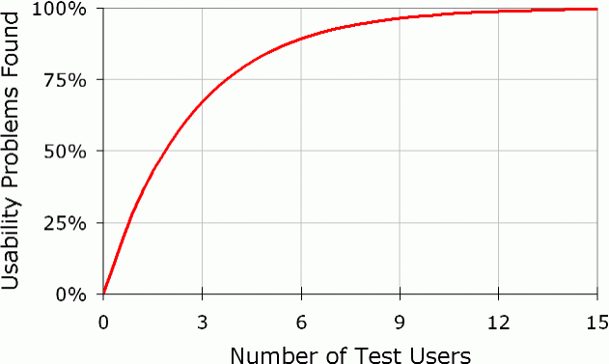
Number of Test Users
Nielsen

Slide 16
Common Pitfalls
Reliability
  Huge differences between test users
  Best user up to 10x efficient
  25% users twice as fast as the slowest 25%
  Who is volunteering – the best or worst?
  May use standard statistical tests
  Number of test users will determine reliability
Validity
  Are we measuring something useful?
  Statistics won’t help here – only common sense and experience

Slide 17
Mini Project
Make two or more Think Aloud Protocol tests of each Hi-Fi Prototype
Length 3-8 min / piece
Video record them
Evaluate them
Consider:
  Should we “train” the users before (depends on type of intended task)
  Should we debrief the user after the session?
  How much “coaching” should we apply?

